Slide 1
(Adventist-Hymnal) App to read the Adventist hymnal on your device
(Isaac Rebolledo)

Slide 2
Revision History
Version | Date | Description | Author
1.0.1 | 2020.06.08 | First version of the app | Isaac Rebolledo

Slide 3
Contents
UI Structure
Usage Scenario
Menu & function description
Key policy
How to change the language

Slide 4
UI Structure
Whole UI Structure
The UI has 3 main tabs
Tab 1: Open hymn from the number
Tab 2: Search the hymn by title, number or content.
Tab 3: Configurate the version of the Hymn-book.

Slide 5
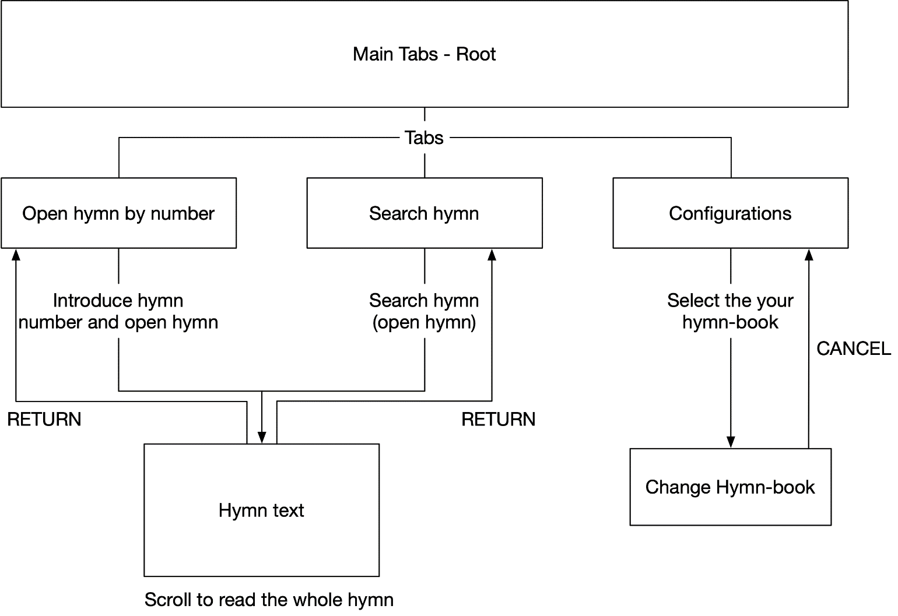
UI structure

Slide 6
Usage Scenario
Open hymn using number
Open the app
Introduce the hymn number you want to open
Tap on “Open”.
Open hymn using the search page
Open the app
Go to SerachTab
Introduce a query to search (number, o word)
Tap on the hymn you want to open.
Change Hymn-book
Open the app
Go to ConfigurationTab
Tap on “Versions and languages”
Select the hymnbook you want to use

Slide 7
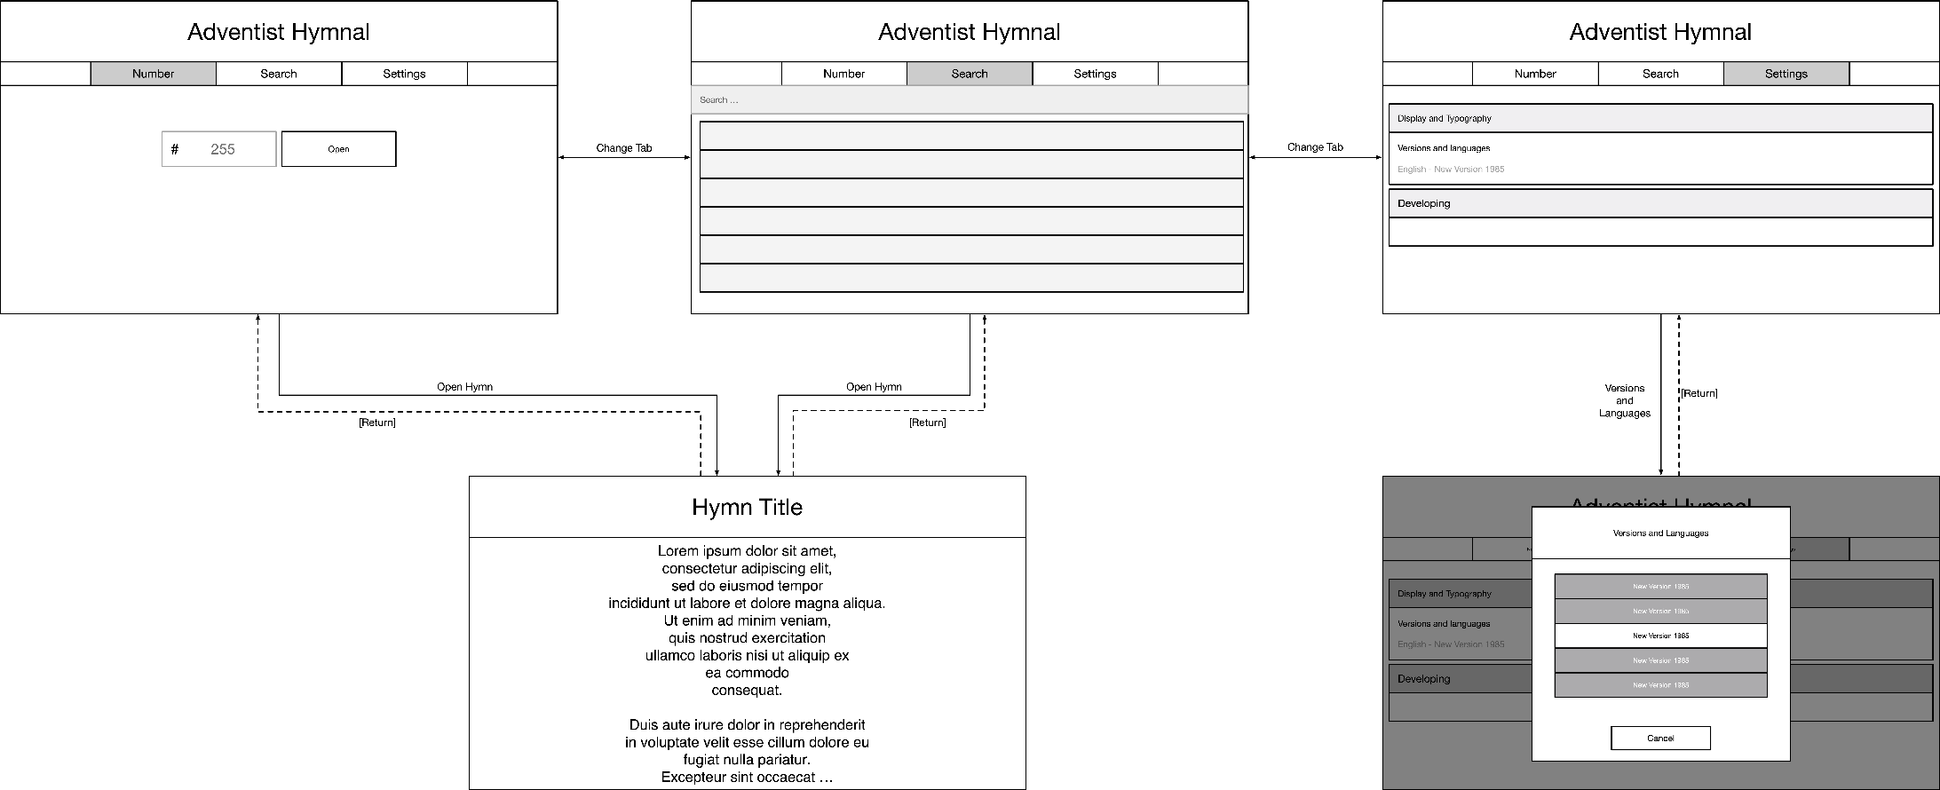
Usage Scenario

Slide 8
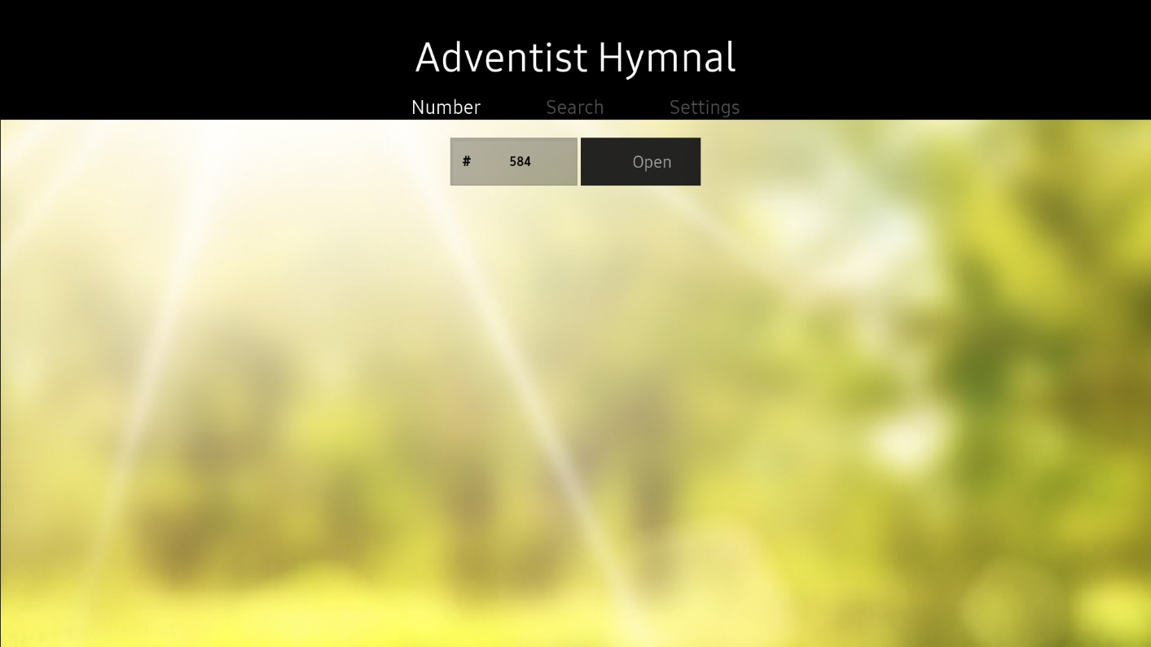
Menu & function description
N° | Element | Attribute
1 | Number Tab | Open Number tab to open a hymn using the number
2 | Search Tab | Open Search tab to search a hymn
3 | Settings Tab | Open Settings Tab to change configurations
4 | Number Field | To Introduce the Hymn Number
5 | Open Hymn | Open the hymn of the hymn number introduced
1
2
3
4
5

Slide 9
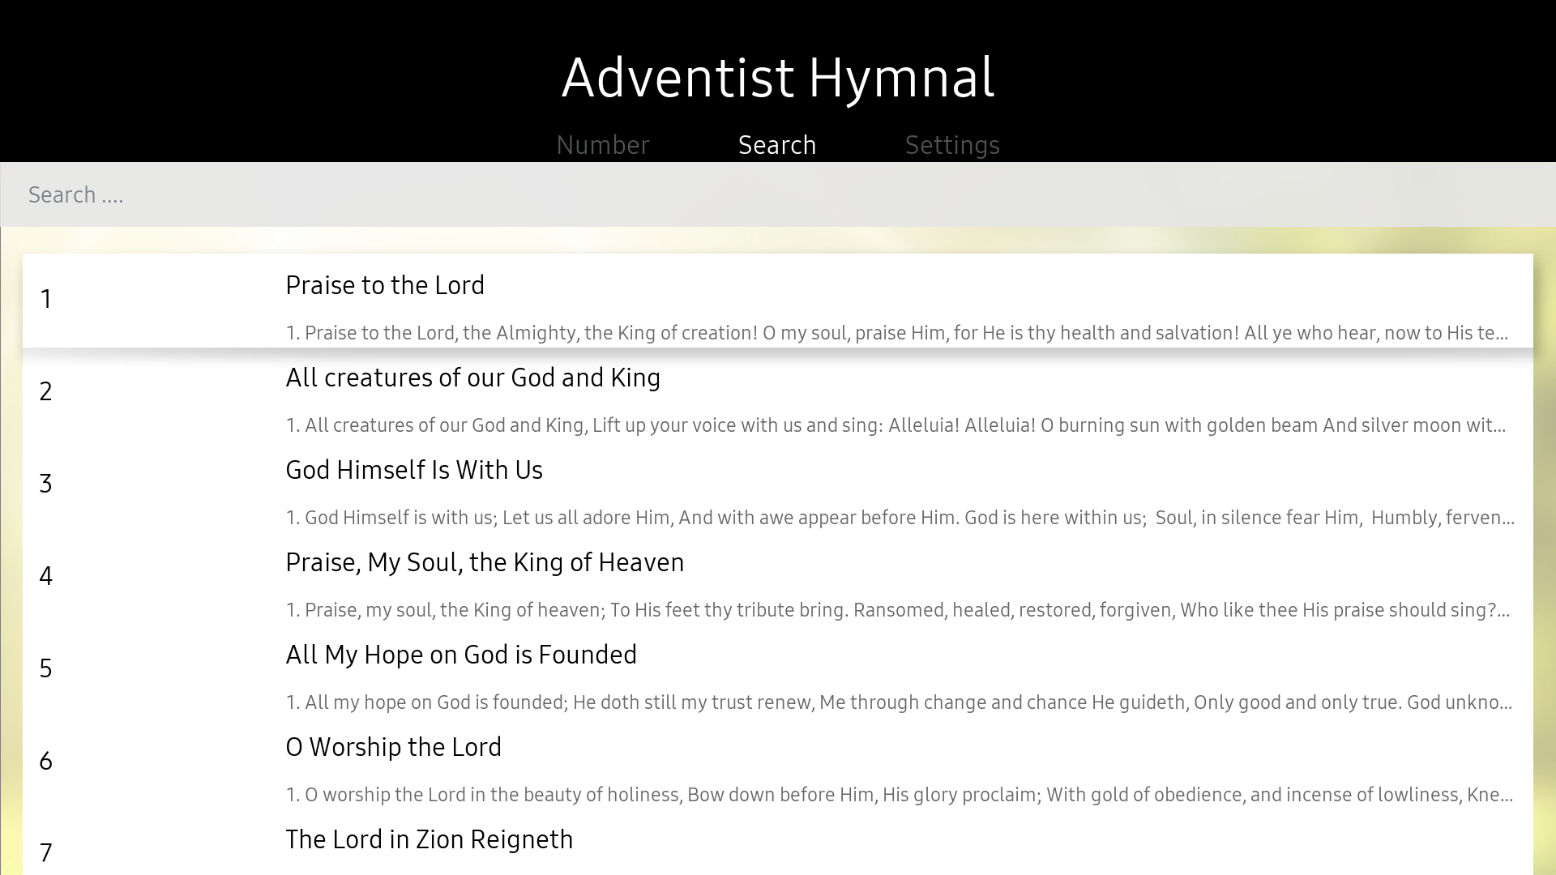
Menu & function description
N° | Element | Attribute
1 | Number Tab | Open Number tab to open a hymn using the number
2 | Search Tab | Open Search tab to search a hymn
3 | Settings Tab | Open Settings Tab to change configurations
4 | Search Field | Search hymn
5 | Hymn | Hymn Cell to open a hymn
1
2
3
4
5

Slide 10
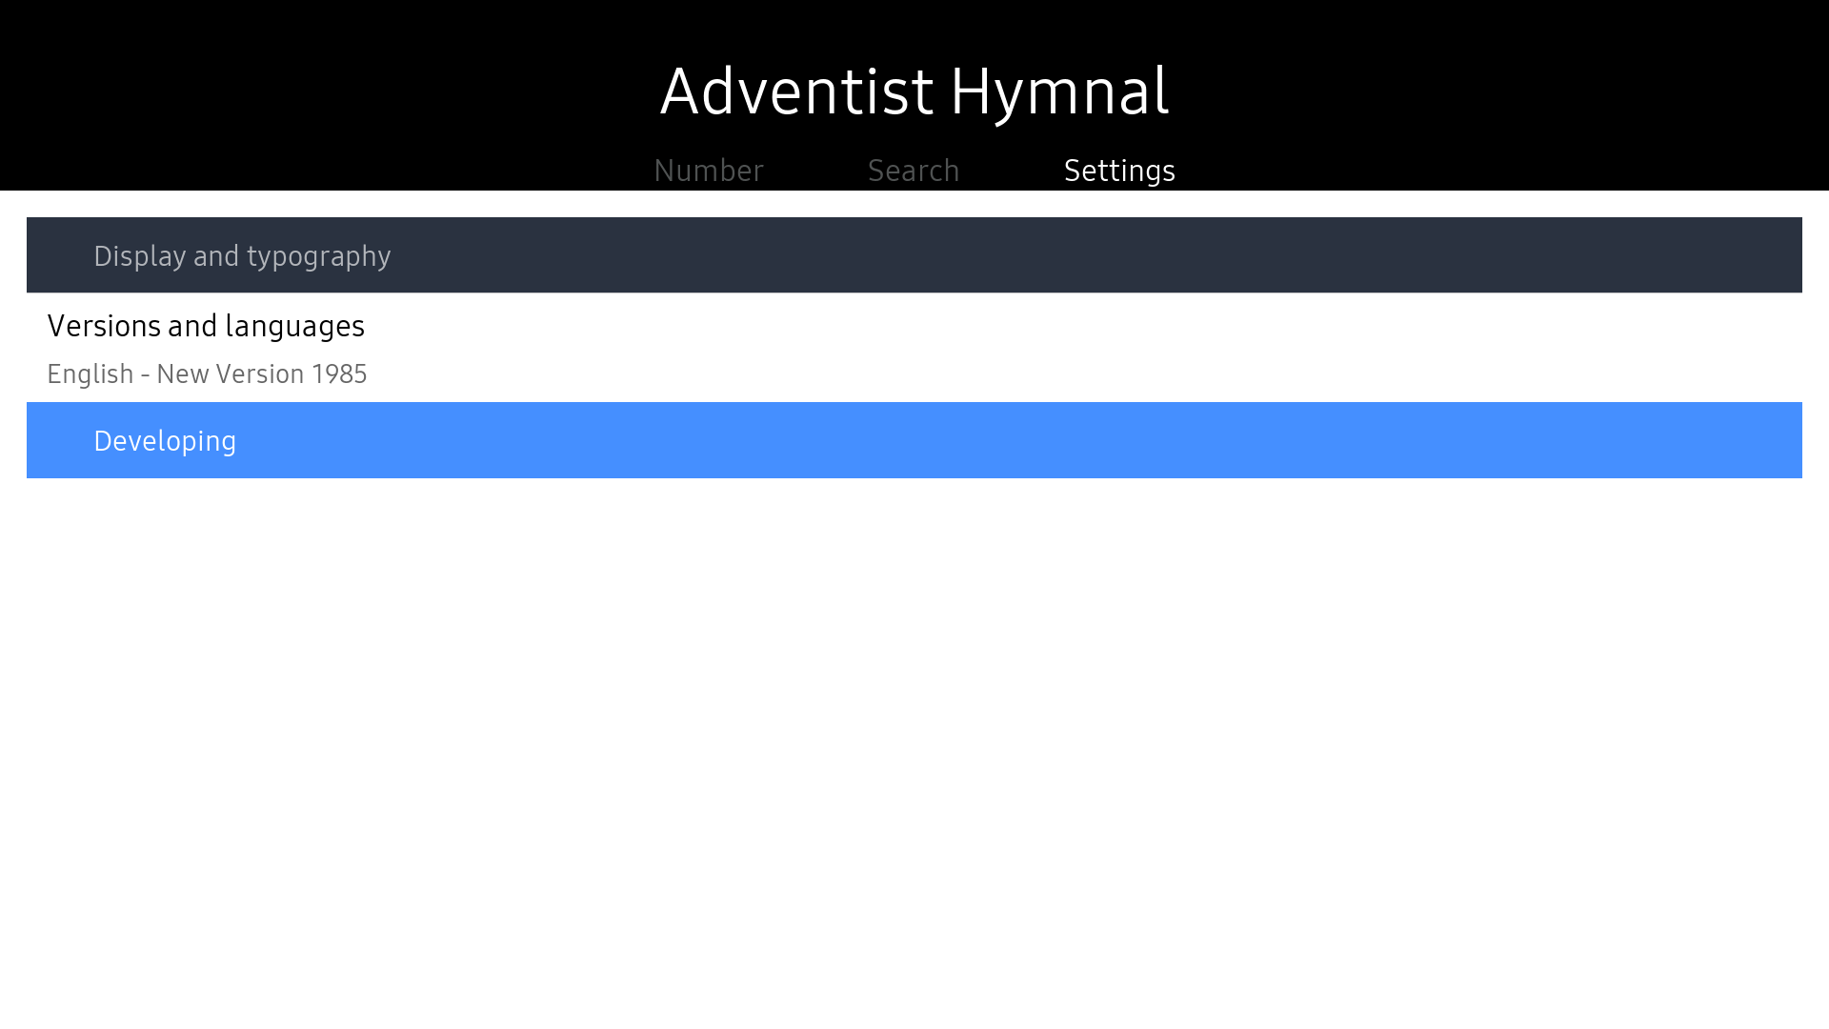
Menu & function description
N° | Element | Attribute
1 | Number Tab | Open Number tab to open a hymn using the number
2 | Search Tab | Open Search tab to search a hymn
3 | Settings Tab | Open Settings Tab to change configurations
4 | Versions and language | Change the hymn-book to use
1
2
3
4

Slide 11
Key Policy
Button | Action | Remarks
RETURN | Move to previous page | Samsung Mandatory
EXIT | Close the app and show broadcasting channel | Samsung Mandatory
RETURN/EXIT | In case of Game App, if game is terminated, the exit popup should be displayed. | Samsung Mandatory

Slide 12
How to change languages
Items | Contents
How to change languages | To configurate the language, change the language of your device.

